Slide 1
Your Daily Meal Assistant - What to eat today?
AC215 - Team Dashers

Slide 2
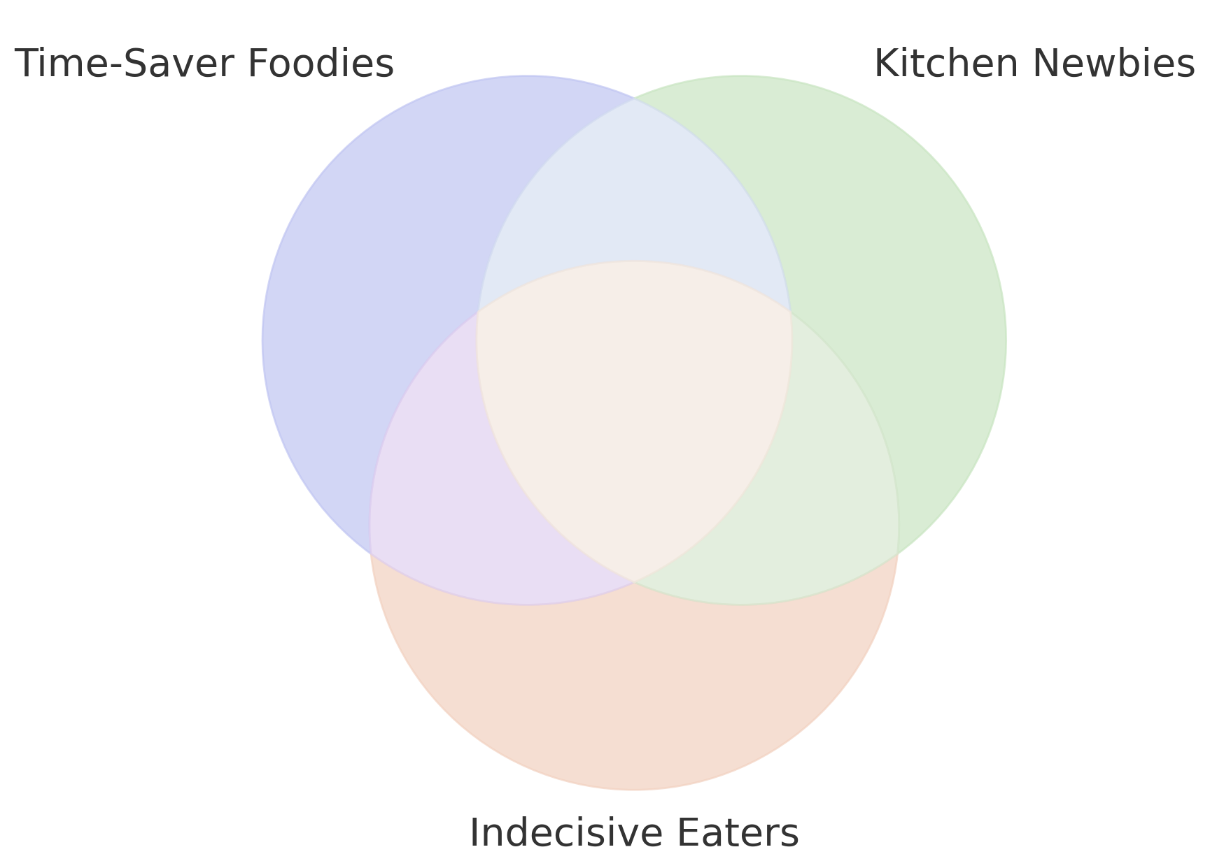

Background
01. Problem Statement
02. Target Audience
Can’t decide what to eat?
Limited time to cook?
Tired of spoiled food in your fridge?
You need a personal meal planning assistant!
Take a picture of your ingredients, you will get a streamline meal planning with:
Recommended recipe with estimated cooking time and calories
Route suggestions for dining out
Food expiry tracker
Notes:
Define the Problem: Clearly articulate the specific problem your AI application addresses.
Identify the Target Audience: Describe who will benefit from your solution (e.g., specific industries, user groups).
Time-Saver Foodies: busy individuals, value Efficiency
Aggregated info, Make quick decisions about what to cook & dining out
Kitchen Newbies: need cooking instructions, value Guidance
Detailed Tutorials in text or video, food expiry reminder, allow them to share newly cooked food
Weekly Food Summary, how health they eat/Style，Social Media
Indecisive Eaters: need personalized suggestions, value Engagement
Information & interaction to make informed decision

Slide 3
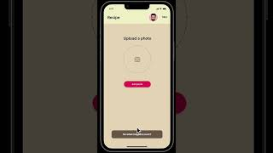
Upload image
Food Detection Model
detected food list
RAG LLM for Recipe Recommendation
Generate most relevant recipe given food list/preference
Satisfied
Save user preferences
Yes
No
YouTube Cooking Tutorial
Google Map
Restaurant Recommendation
Notes:
Highlight Uniqueness: Explain what sets your solution apart from existing alternatives.
Demonstrate Value: Illustrate how your AI application provides unique benefits to the target audience.

Slide 4
Unique Value Proposition
Smart Integration of AI Technologies | Competitors | Our Benefits
Object Detection: update inventory effortlessly LLM: personalized recipe recommendation API calling agent: Dine-out: Google map Cook: YouTube | Fail to offer end-to-end solution: - No ingredient expiry tracker - No "cook-or-dine" comparison - No personalized food profile - No ingredient-driven recipe recommendation | Efficiency: - Automate ingredient tracking - Cost, Time, Health Guidance: - Video cooking tutorials - Map navigation to restaurants Engaging: - Decision-Making Aid - Weekly Summary Visuals
Notes:
Highlight Uniqueness: Explain what sets your solution apart from existing alternatives.
Demonstrate Value: Illustrate how your AI application provides unique benefits to the target audience.
Automated inventory management
Smart decision engine: cook vs. dine-out
Personalized food profiles
Integrated learning: video tutorials
Location-based restaurant recommendations

Slide 5
Scalability and Efficiency
Model Selection and Performance Optimization
Core Features Implemented
Food Detection + Recipe Generation
Food Detection: GPT-4o-mini
Contextual Understanding
educated guess on partially visible/ambiguous items
Textual Descriptions
generate descriptive text
Flexibility and Accuracy
Notes:
Technical Scalability: Discuss how your application can scale to meet growing demands.
Performance Optimization: Explain any optimizations implemented for efficiency (e.g., fine-tuning, infrastructure choices).
Infrastructure Considerations: Briefly mention the technologies used (e.g., GCP, Docker, Vertex AI) and why they were chosen.

Slide 6
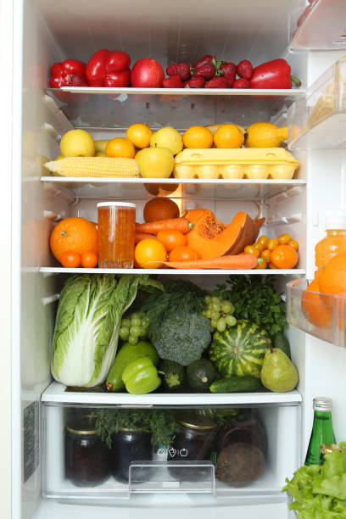
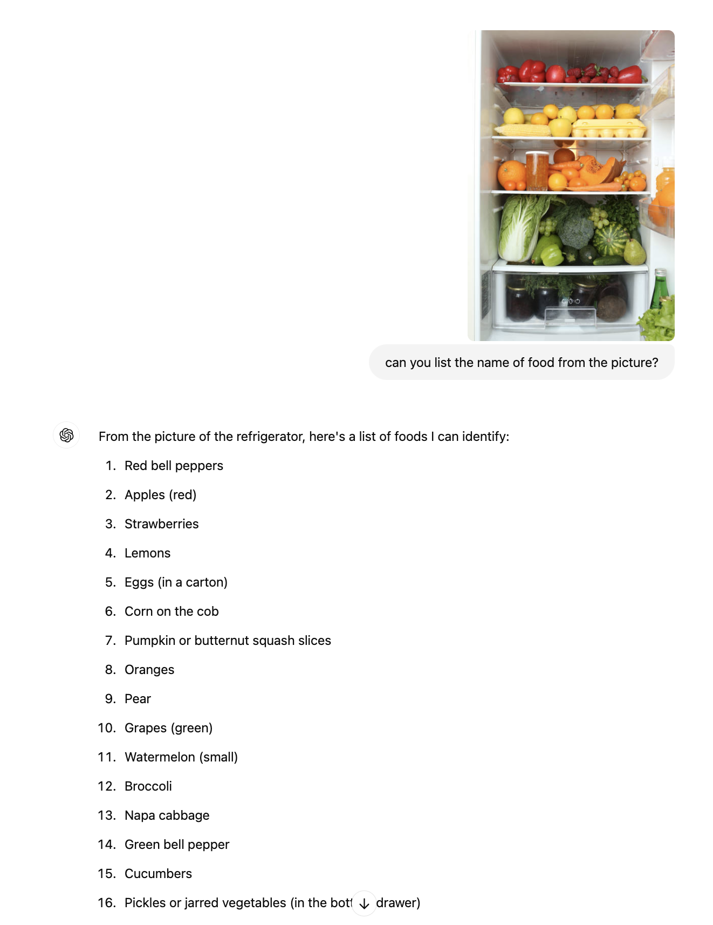
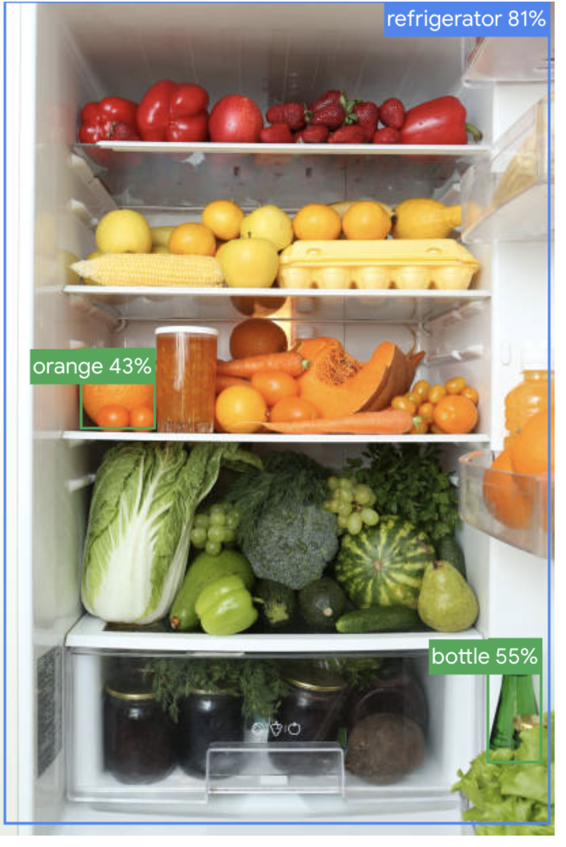
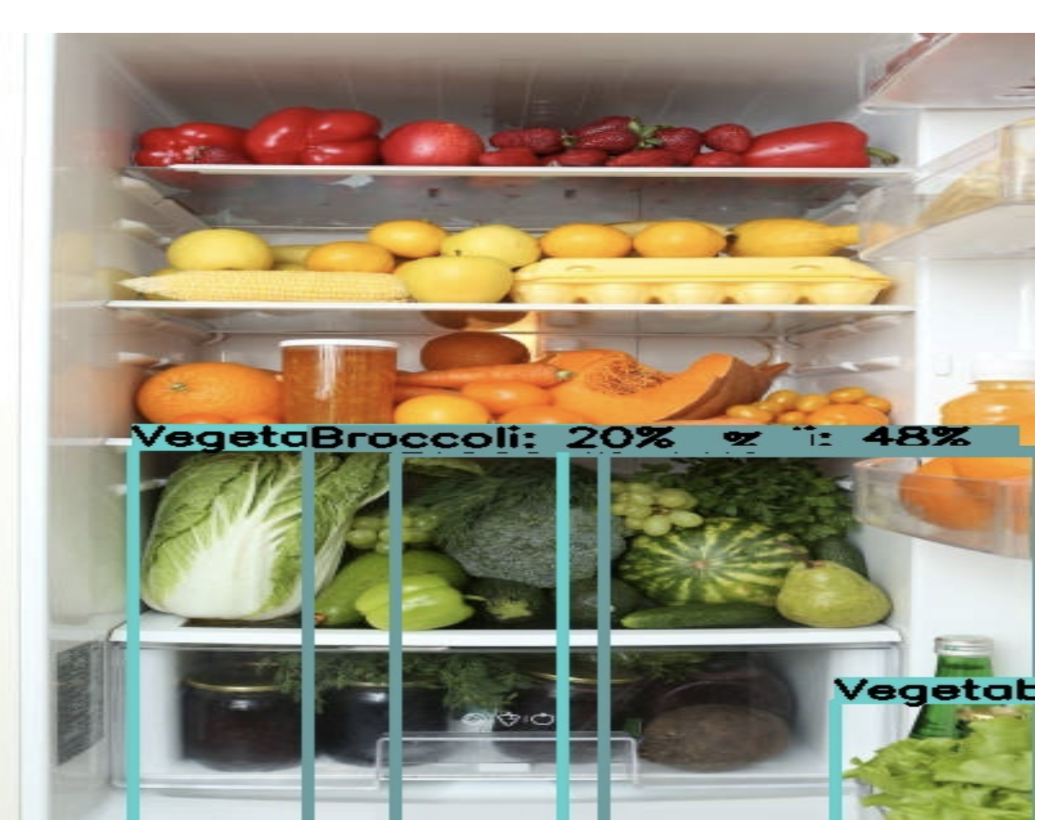
Scalability and Efficiency
Model Selection and Performance Optimization
Object Detection Model Selection
Input
GPT
EfficientDet-Lite0
YOLOV8s (Finetuned)
Notes:
Technical Scalability: Discuss how your application can scale to meet growing demands.
Performance Optimization: Explain any optimizations implemented for efficiency (e.g., fine-tuning, infrastructure choices).
Infrastructure Considerations: Briefly mention the technologies used (e.g., GCP, Docker, Vertex AI) and why they were chosen.

Slide 7
Scalability and Efficiency
Recipe Generation: RAG with Finetuned Gemini 1.5 Flash
Fine Tuning Motivation
Improve Contextual Understanding/Refine Recipe-Specific Embeddings
Prevent Hallucinations
Training Data
Raw Data: Recipes data with titles, ingredients, and preparation directions
Training Data: 5000 question-answer pairs
Q: "How do you prepare [recipe title] using these ingredients: [ingredients ]?"
A: corresponding recipe directions.
Notes:
Technical Scalability: Discuss how your application can scale to meet growing demands.
Performance Optimization: Explain any optimizations implemented for efficiency (e.g., fine-tuning, infrastructure choices).
Infrastructure Considerations: Briefly mention the technologies used (e.g., GCP, Docker, Vertex AI) and why they were chosen.

Slide 8
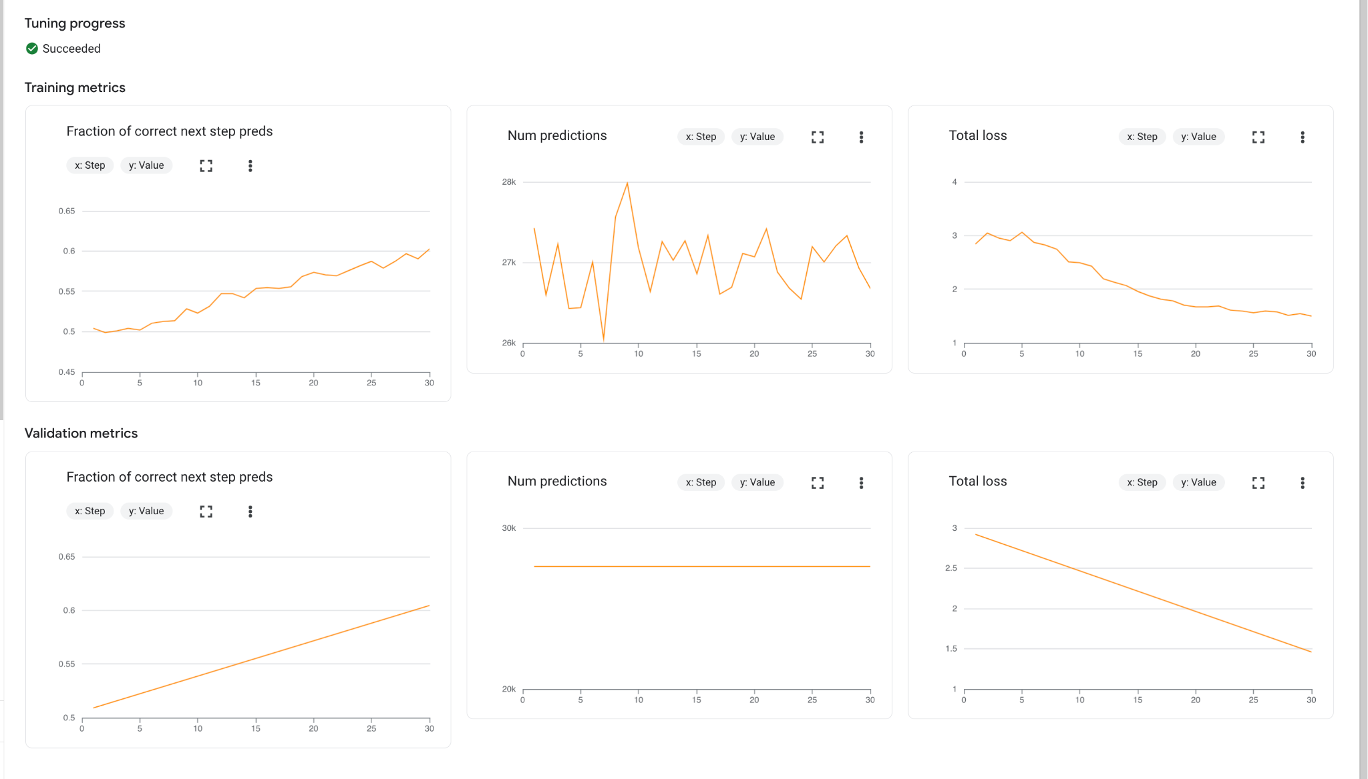
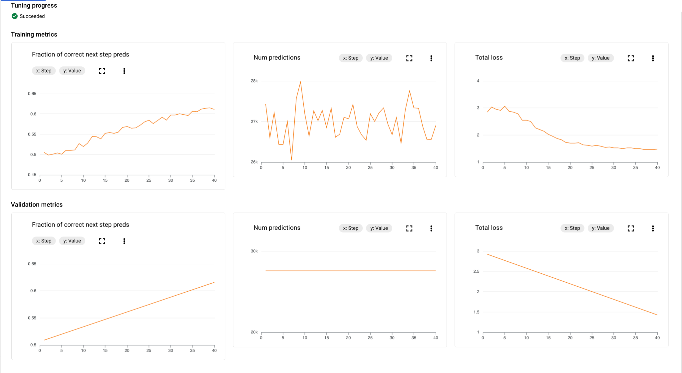
Scalability and Efficiency
Recipe Generation: RAG with Finetuned Gemini 1.5 Flash
Fine Tuning Process
Base Model: gemini-1.5-flash-002
Hyperparameters
v1: epochs=3, adapter_size=4, learning_rate_multiplier=1.0
v2: epochs=4, adapter_size=4, learning_rate_multiplier=0.9
Notes:
Technical Scalability: Discuss how your application can scale to meet growing demands.
Performance Optimization: Explain any optimizations implemented for efficiency (e.g., fine-tuning, infrastructure choices).
Infrastructure Considerations: Briefly mention the technologies used (e.g., GCP, Docker, Vertex AI) and why they were chosen.

Slide 9
Scalability and Efficiency
RAG
Recipe vector database (example in the table)
Self-RAG
Auto-determine when to use vector embedding searching
Filter out irrelevant information when embedding queries
Extract an unquantified food list and styles (Query):
ex. [dough, pizza source,...]
Title | Ingredients | Unquantified ingredients (Key) | Directions (Value) | Style
Jewell Ball’s Chicken | ["1 small jar chipped beef, cut up", "4 boned …] | ["beef", "chicken breasts", "cream of mushroom…] | ["Place chipped beef on bottom of baking dish....] | Casserole

Slide 10
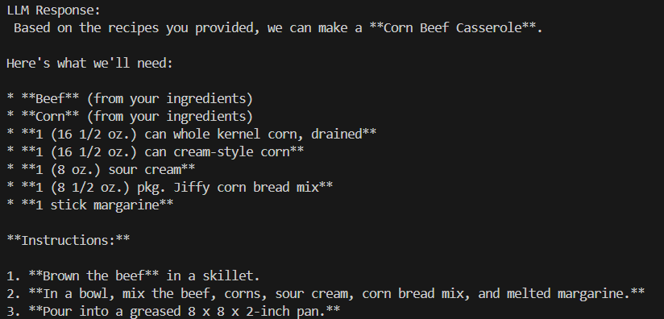
CLI example response

Slide 11
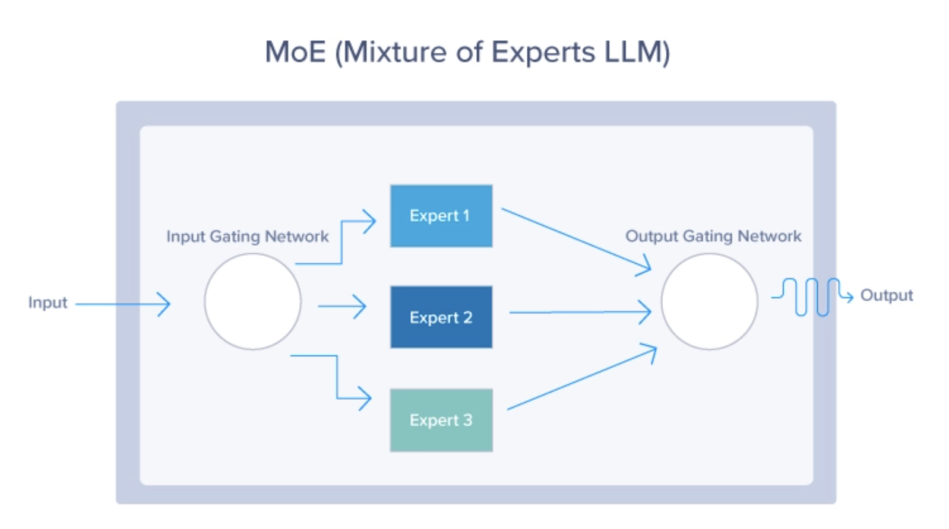
Scalability and Efficiency
Technical Scalability
Gemini 1.5
Mixture-of-Experts (MoE) Architecture
Divides into smaller/ specialized networks
Activate a subset of experts for each input
Serverless Computing: Google Cloud Run
Supports up to 80 concurrent requests (configurable to 1000 max)
Scalability tested with Google Kubernetes Engine
Notes:
GEMINI: Instead of having a single massive neural network, MoE divides the model into smaller, specialized "expert" networks. Utilizes a routing function to activate only a subset of model parameters for each input Scalability: This allows for scaling the model by adding more experts or increasing their capacity without drastically increasing the computational cost for every input.Efficiency: Since only a subset of experts is activated for each input, MoE makes Gemini more efficient to train and run, especially for complex tasks and diverse data.
Serverless Computing: quickly autoscale to handle zero to varying high request volumes

Slide 12


Infrastructure Considerations
GCP
Scalable cloud infrastructure; ideal for large data & model demands.
Vertex AI
Streamlined model training/deployment/ monitoring
Docker
Consistent environments across development/ production
DVC
Facilitates version control for datasets/ model files
GCP
GCS Bucket
Vertex AI
Ingredients List
Recipe
Recipe
Retrieval
Data&Models
Model Deployment
Recipe
Raw Image
Chat
History
Data Versioning Container
Object detector Container
Train Container
Fintuned Model
Inference Container
Recipe generator
Application Deployment
Notes:
GCP: Chosen for its scalable cloud infrastructure, providing a secure, high-performance environment to handle large data and model demands.
Vertex AI: Enables streamlined model training, deployment, and monitoring with built-in MLOps support, ideal for managing machine learning workflows.
Docker: Allows for containerization, ensuring consistent environments across development and production, making the application portable and easy to deploy.
DVC: Facilitates version control for datasets and model files, helping manage experiment tracking and data versioning across different stages of development.
For our app’s infrastructure, we employs GCP, vertex AI, and docker containers. Those containers would be uploaded to GCP and interact with GCS bucket for consistent user experience with high volumes of data flow. And our recipe generator model will mainly utilize the Vertex AI infrastructure for streamlined model deployment process with built-in .

Slide 13

Future Development
1. Build Vertex AI pipeline
Automate the workflow
2. UI integration with WhatsApp
Easy to start for users
Bigger Picture?
Vertex AI
Notes:
Next Steps: Outline your plans for further development of the AI application.
Market Growth: Discuss the potential for market expansion and how your solution can adapt.

Slide 14
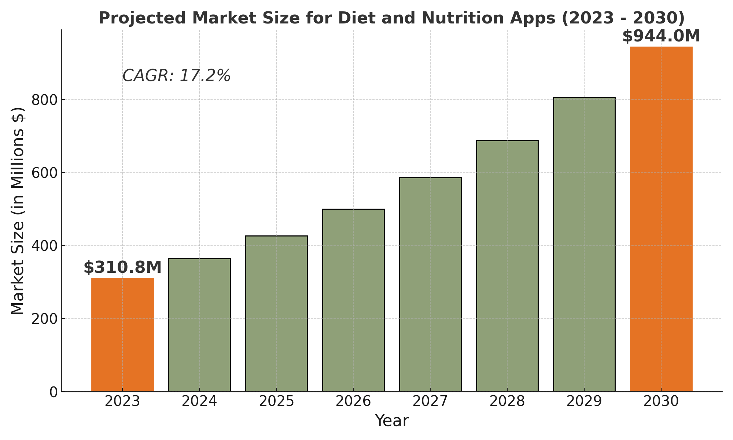
Market Growth
Notes:
Next Steps: Outline your plans for further development of the AI application.
compound annual growth rate
Market Growth: Discuss the potential for market expansion and how your solution can adapt.

Slide 15
Market Growth
Lifestyle influenced chronic disorders: 422 million individuals have diabetes globally in 2023
Key drivers
Health Consciousness
Prevalence of Obesity
World Obesity Federation: 1 billion people have been estimated to be living with obesity by 2030 globally
Notes:
Next Steps: Outline your plans for further development of the AI application.
compound annual growth rate
Market Growth: Discuss the potential for market expansion and how your solution can adapt.

Slide 16
Future Development
Data Tracking for Health and Diet Outcomes
Develop Health-Focused Recipe Recommendations
1. Allow user to set dietary goals related to weight management, diabetes control…
2. Collect user feedback for continuous improvements
1. Create Recipe Categories Targeting Chronic Conditions
2. Add Filters for Dietary and Health Goals
Daily Meal Assistant
high-fiber
nutrient-dense
low-sugar
Partnership with Food and Health Brands
Notes:
Next Steps: Outline your plans for further development of the AI application.
Market Growth: Discuss the potential for market expansion and how your solution can adapt.

Slide 17

Thank you!
Let’s Q&A…

